Slide 1

Presentation Topics: IOT And It’s Security
Barani Institute of Management Sciences

Slide 2

Agenda
What is IoT?
Why they are called LLNS?
How messages passed through IoT.
What are internal attacks?
How do internal attacks work?
How do we mitigate internal attacks?
What are algorithms and techniques?
How information security can help to mitigate internal attacks?

Slide 3

What is IoT?
IoT stands for Internet of Things, which refers to the network of physical objects that are embedded with sensors, software, and connectivity to exchange data with other devices and systems over the Internet.
75 billion connected devices in 2025

Slide 4
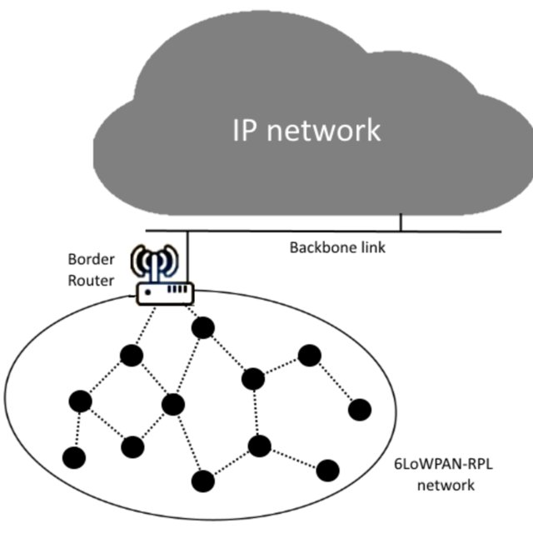
Why they are called LLNS?
Low-power and Lossy Networks (LLNs) are a type of wireless network used in the Internet of Things (IoT) that are designed to operate with limited power and bandwidth resources.
LLNs are typically made up of a large number of devices with low-power radios that are capable of communicating wirelessly with other devices within the network. These devices can include sensors, actuators, and other types of embedded systems.

Slide 5
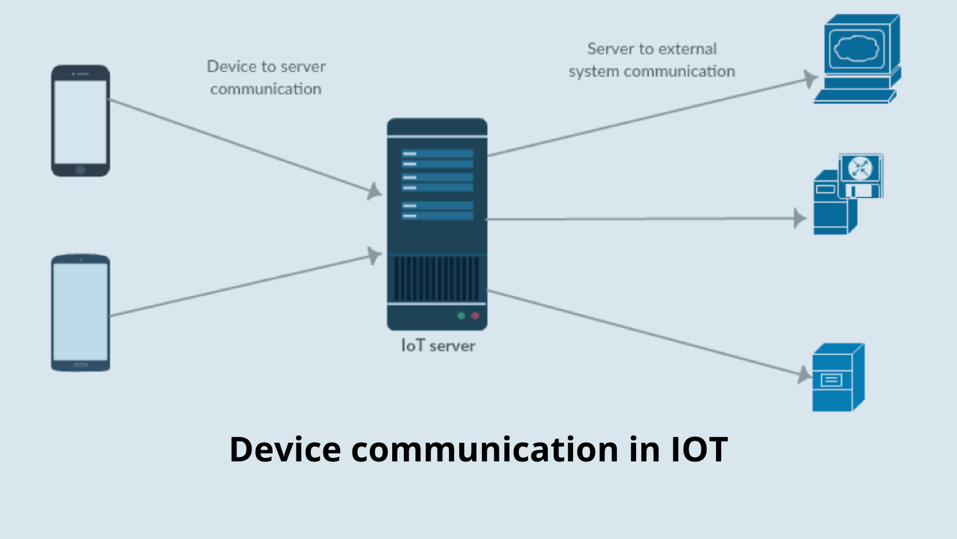
How messages passed through IoT.
In the IoT, messages are passed through a network of interconnected devices that are embedded with sensors, software, and network connectivity.
These devices communicate with each other using a variety of wireless and wired communication protocols such as Wi-Fi, Bluetooth, Zigbee, and Z-Wave.

Slide 6
Continue:
The messages are typically sent from one device to another until they reach their destination.
The devices can be remotely monitored and controlled using cloud-based services that provide real-time data analytics and insights.

Slide 7
What are internal attacks?
Internal attacks in IoT refer to the unauthorized access or manipulation of IoT devices by someone who has legitimate access to them.
This can include employees, contractors, or even customers who have been granted access to these devices.Internal attacks can be intentional or unintentional, and they can cause significant damage to the organization's infrastructure and reputation.

Slide 8
Types of IoT security attacks.
DOS
DDOS
Information manipulation
Unauthorized access
Information disclosure

Slide 9
How do internal attacks work?
Internal attacks in IoT typically start with a compromised device or account.
An attacker may gain access to a device through a weak password or exploit a vulnerability in the device's firmware.

Slide 10
Continue:
Once inside, the attacker can move laterally across the organization's network, gaining access to other devices and systems.
They can then use these devices to launch further attacks, steal data, or cause damage to the organization's infrastructure.

Slide 11
IOT AND ITS SECURITY
HOW WE MITIGATE INTERNAL ATTACKS?
Mitigating internal attacks in IoT (Internet of Things) environments requires a unique approach due to the distributed nature and diversity of IoT devices. Here are some measures that can help mitigate internal attacks in IoT environments:
Secure Communication
Network Segmentation
Device Authentication
Regular Firmware Updates
Access Control
Monitor and Analyze Network Traffic
Data Encryption
Threat Modeling

Slide 12
SECURE COMMUNICATION:
IoT devices should use secure communication protocols, such as SSL/TLS, to encrypt data in transit. This can help prevent attackers from intercepting and manipulating data exchanged between devices and other network components.
NETWORK SEGMENTATION:
Network segmentation can help limit the spread of attacks by separating IoT devices into different network segments. This can prevent attackers from moving laterally across the network to gain access to other devices or sensitive data.

Slide 13
DEVICE AUTHENTICATION:
Device authentication can help ensure that only authorized devices are allowed to communicate with the network. This can be achieved through the use of digital certificates, secure tokens, or other authentication mechanisms.
REGULAR FIRMWARE UPDATES:
IoT devices should be updated regularly with the latest firmware updates and security patches. This can help prevent attackers from exploiting known vulnerabilities in the device's software and reduce the risk of internal attacks.

Slide 14
ACCESS CONTROL:
Access control policies should be in place to ensure that only authorized personnel can access and configure IoT devices. This can help prevent employees or other insiders from making unauthorized changes to the devices, which could result in security breaches.
MONITOR AND ANALYZE NETWORK TRAFFIC:
Monitoring and analyzing network traffic can help detect unusual activity, such as unauthorized access attempts or unusual data flows. This can help security teams identify potential security breaches before they cause significant damage.

Slide 15
Techniques of IoT
Ubiquitous computing
WSN
RFID
Context Awareness

Slide 16
Ubiquitous computing
Ubiquitous computing is a concept in computer science and engineering that refers to the integration of computing and communication technologies into everyday objects and environments

Slide 17
Wireless Sensor Network
A wireless sensor network is a collection of distributed, small, low-power, and wireless devices called sensor nodes that are capable of sensing, processing, and communicating data over wireless channels.
The purpose of WSNs in IoT applications is to collect and transmit data from the physical world to the cloud or other computing resources for further analysis and processing.

Slide 18
Radio Frequency Identification
it is a wireless communication technology that uses radio waves to identify and track objects or people. In an RFID system, a tag is attached to the object or person being tracked, and a reader emits radio waves to detect and read the information stored on the tag.
RFID tags can be either passive or active.

Slide 19
Context Awareness
Context awareness is an important concept in IoT that refers to the ability of devices and systems to detect and respond to changes in the user's environment and behavior.

Slide 20
Algorithm of IoT
Data Collection:
Data Processing:
Data Storage
Data Transmission
Data Analysis

Slide 21
Information security to migrate Internal attacks:
Information security can play a critical role In migitating Internal attacks
by implementing a range of preventive, detective and corrective controls.

Slide 22
Some of the measures that can help are:
Access controls.
Employee training.
User-activity monitoring.
Seperation of duties.
Incident response plan.
Regular audits and assessment.

Slide 23
1. Access controls:
Access controls help to provide unauthorized access to sensitive data and systems.
2. Employees training:
It is crucial to provide regular training to employees on information security policies and procedures, including how to identify and report suspicious activities.
3.User-activity monitoring:
Monitoring user activity can help detect suspicious behavior or activities such as attempts to access unauthorized systems or data.

Slide 24
4.Seperation of duties:
Separating duties among employees and limiting the scope of access to systems and data can reduce the risk of insider attacks.
5. Incident response plan:
Developing an incident response plan that outlines how to respond to internal attacks is crucial.
6.Regular audits and assessment:
Regular audits and assessments of information security controls can help identify vulnerabilities and weakness that can be exploited by internal attackers.

Slide 25
By implementing these controls, organizations can help to mitigate the risk of internal attacks. However, it’s important to note that no system is foolproofs, and organizations should always be prepared to respond quickly and effectively to security incident.

Slide 26

Thank You

